Slide 2
INTRODUCTION
ampliFI Your Member Engagement with Rewards
Mike Hamblin & Courtney Wingo

Slide 3
INTRODUCTION
Introduce ampliFI Loyalty Solutions
Mike Hamblin
Sr. Sales Executive
Introduce Allied Federal Credit Union
Courtney Wingo
Chief Operations Officer

Slide 4
ampliFI Loyalty Solutions
PRODUCT AWARENESS
Mike Hamblin

Slide 5
PRODUCT AWARENESS
ampliFI Loyalty Solutions is the market leading, customizable, and fully outsourced provider of loyalty and engagement programs for financial institutions
Credit Union- centric Organization:
MAP Partnership for 10 yrs+
70%+ of our
clients are CU’s
Partner with 40% of the Top 50 CU’s
25+ years of supporting nearly 2,100 loyalty programs;
Pure loyalty program provider; 100% focus and dedication to
loyalty & engagement strategies and execution
Seamless integration to most of the industry vendors, processors and mobile providers, featuring single sign-on and API technology; multi-network support
5

Slide 6
Loyalty Reinvented
Customized Branding
& Design with Multi- Program Enablement
Card & Rewards Portfolio Insights & Data Analytics
Customized Earning and Redemption Offerings and Financial Control
ampliFI provides a fully outsourced end-to-end rewards program that offers issuing partners an innovative and dynamic solution to drive loyalty and engagement with their cardholders.
Turn-Key Card KPI Growth Campaigns and
Promotions with Full-Service Marketing and Support
Industry- Leading Innovation and Enhancements
Processor, Digital, and Core Provider and Technology Agnostic
©2022 Visa. All rights reserved. Visa confidential

Slide 7
PRODUCT AWARENESS
Real Time Rewards
Pay With Points Fuel With Points
Checkout With Points
Surprise and delight cardholders with a reward before they leave the store. Real- time and near instant messaging directly links reward to purchase.
Gift Cards and eGift Cards
150+ gift card options from the most popular merchants.
Includes e-gift cards for most merchants.
Cash Back
Many cash back options including statement credits, deposit to checking & savings, or deposit to any account.
Travel
Airline tickets, hotels, car rental, cruises and vacation getaways.
Experiences
Unique lifestyle experiences from golf trips to white water rafting.
Custom Solutions
Include your products, such as a donation to your foundation, % off a loan rate, refund a fee, etc.
These items are client- fulfilled.
Local Event Tickets
Includes sporting events, plays, comedy shows, even exclusive sold-out events to the public – all in real time.
Prepaid Debit
Acts like a cash reward. Highly motivational and desirably simple.
Personalized Charitable Donations
Merchandise
An extensive collection of brand-name rewards including cameras, tablets, gaming consoles and much more.
A meaningful way to pay it forward, donations can be designated to charities of their choice.
7

Slide 8
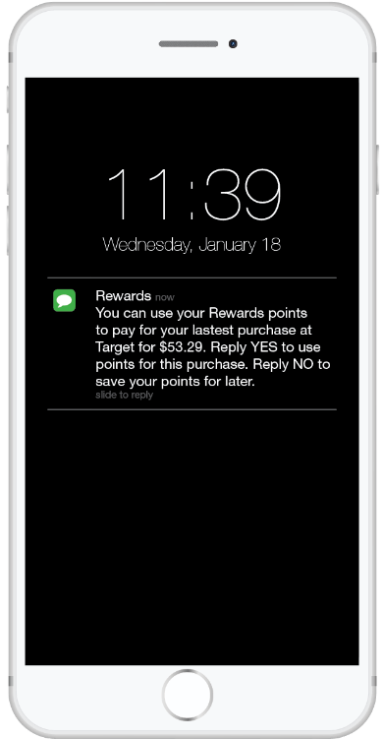
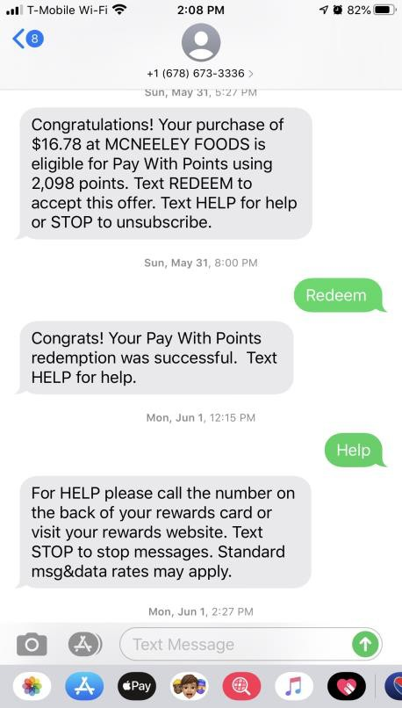
Pay With Points
Near-Real Time
Ease of Use Innovation
Increased Engagement
Convenience
1
All Accounts Enrolled
2
Make a Qualifying Purchase
3
Receive Notification
4
Click “Redeem”
5
Redemption Confirmation
6
Credit Applied Back to Card

Slide 9
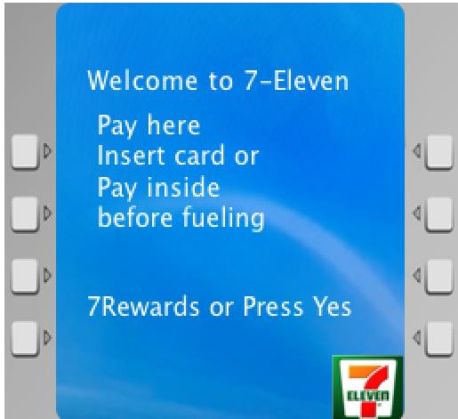
Fuel With Points
Cardholders prompted at the
pump to choose whether they’d like to redeem points to discount their fuel
If cardholder chooses yes, the per- gallon fuel price is discounted, and points are earned for the remaining amount
REDEEM 2,000 REWARDS POINTS FOR A $0.50 DISCOUNT TODAY?
YES
NO
$3.50
$3.00
Example Participating Stations Include:

Slide 10
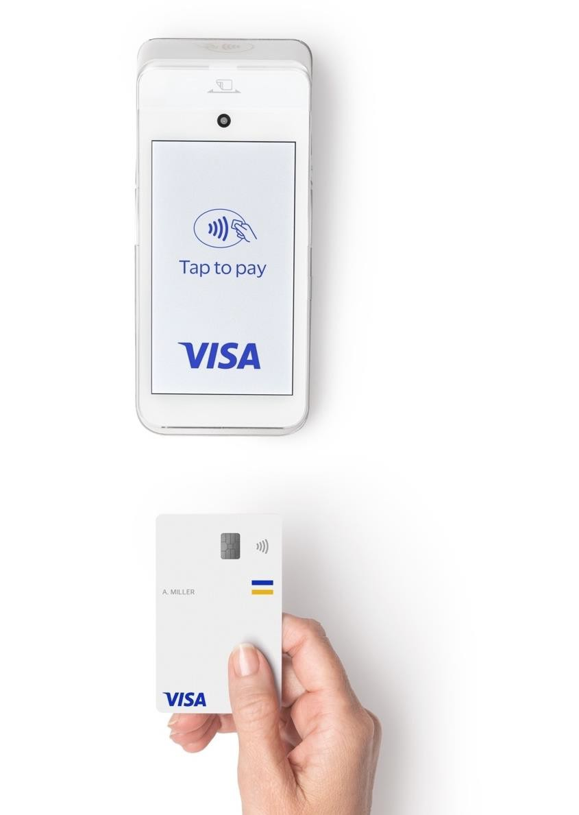
Checkout With Points
Cardholder is prompted at the point of sale to choose whether
they’d like to redeem points to discount their purchase
If cardholder selects ‘YES’, then $10.00 is taken off their transaction and points are earned for the remaining amount
Item 1
Item 2
$25.00
$25.00
TOTAL
Points Discount TOTAL
$50.00
-$10.00
Would you like to use 1,000 of your points to take
$10.00 off this transaction?
$40.00
10
12
©2022 Visa. All rights reserved. Visa confidential

Slide 11
The Power of Engagement: Redemption Client Case Study
+$148.66
interchange revenue per account*
12-Month Transactions per Cardholder
12-Month Spend per Cardholder
250
$14,000
196
$12,299
200
$12,000
+ 176% /
+ 204% /
50,000
approximate new redeemers*
150
125
$10,000
$8,259
$8,000
100
71
$6,000
50
$4,040
+$7.4 M
additional interchange revenue*
$4,000
0
$2,000
Non-Redeemers
Redeemers
$0
Non-Redeemers
Redeemers
SOURCE: internal ampliFI client data
* Estimated impact for example only, assuming 1.8% exchange rate

Slide 12
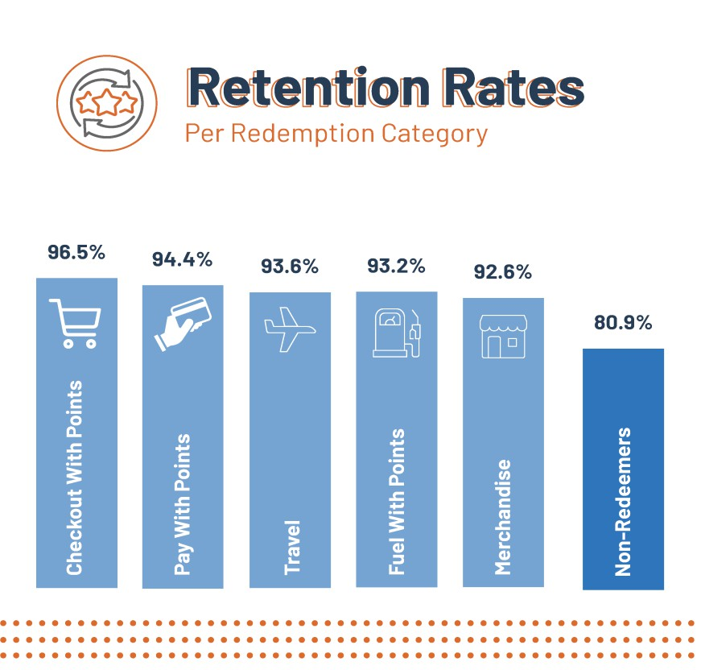
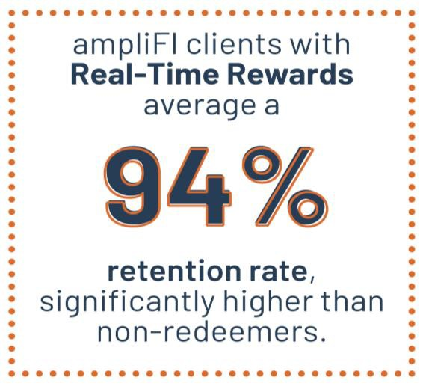
The Impact of Redemptions on Cardholder Retention

Slide 13
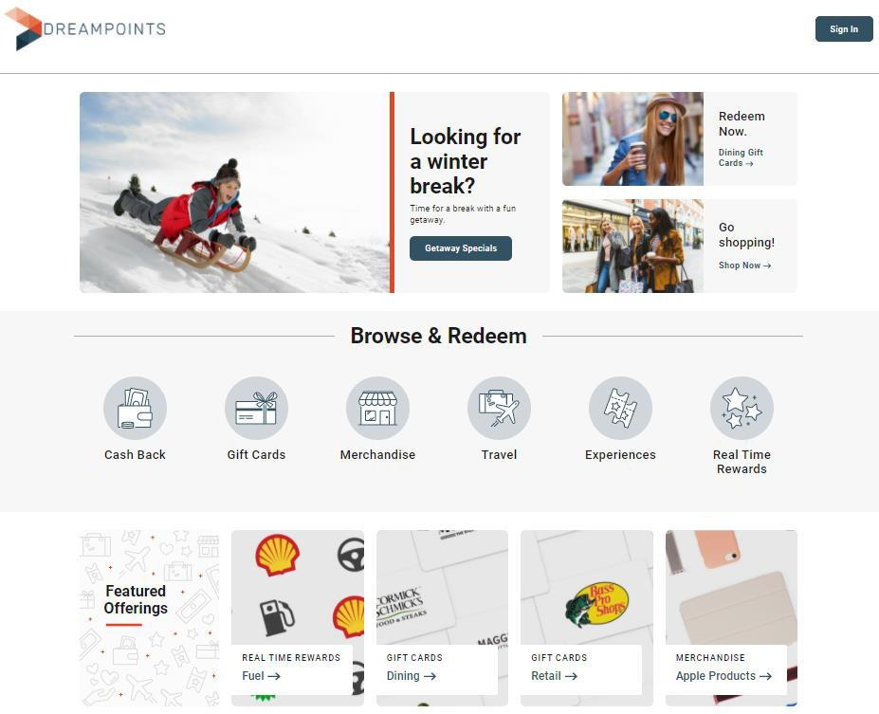
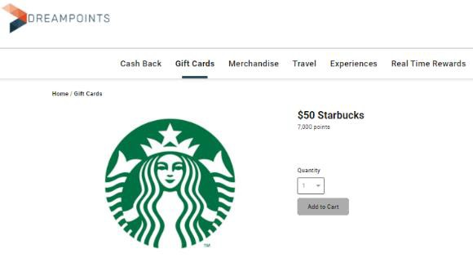
Custom Branded Website Experience
Single sign-on (SSO) and API integration with your digital platforms
Customizable to FI’s branding
requirements
State of the art, modern design
Fully mobile responsive and ADA compliant
An intuitive experience with easy rewards browsing and account summary as well as a quick check- out process

Slide 14
ampliFI Loyalty Solutions
CREDIT UNION APPLICATION
Mike Hamblin & Courtney Wingo

Slide 15
APPLICATION
What problems did the product help solve?
Custom-branded program name and website
Members more actively engaging with the rewards program
More real-time redemption options (utilize new “throttling” feature)
Throttled to 1 redemption at CWP per month.
Better member servicing for rewards
Previous vendor pushed members back to the credit union, Amplifi helps
More strategic and reliable program support for CU staff
Campaigns for specific merchant types planned for 2025 to drive interchange income further

Slide 16
Purchasing Timeline and Implementation
1
Solutions Brief and Deep Dive
Review program offering, pricing and initiate follow-on deep dive
Solution Deep Dive and Program Design
Review key technical decisions, assess existing file and data flows, document high level
solution design and align project resources
2
Implementation and GTM (90-120 days)
Initiate development workstreams, develop marketing plan and market entry/launch
strategy
3

Slide 17
CREDIT UNION ANALYSIS
Operational Efficiencies:
Faster balancing for accounting/invoice processing
Research easier due to great UIX
Amplifi support extremely responsive
Increased member value:
Redemptions increased significantly with Checkout With Points (CWP) 87.40% of total
Members no longer feel the need to “save” points for holiday usage in Q4
Enhanced card portfolio:
Dollars spent by members increased month over month which improved interchange income
10/2023 dollars spent $3,312,470
07/2024 dollars spent $4,242,069

Slide 18
ampliFI Loyalty Solutions
ACTION ITEMS & RESOURCES
Mike Hamblin & Courtney Wingo

Slide 19
ACTION ITEMS AND RESOURCES
Two or three items that attendees could do immediately
after the session when they get back to their Cu’s
Check to make sure you are offering rewards on credit and debit
If you have a rewards program, make sure you have options for real-time redemptions, learn about them, and utilize them
Reach out to MAP to get a program comparison vs the ampliFI solution

Slide 20
ACTION ITEMS AND RESOURCES
Resource list of other MAP client CUs of varying asset sizes that use the product:
Palmetto Citizens FCU
Unify Financial CU
Alabama State Emp CU
Glendale Area Schools CU
Alatrust CU
Credit Union of the Rockies
Unitus Community CU
Eagle One CU
Our Community CU
Bluestone CU
Northridge Community CU
Nordstrom CU
Calcoe FCU
Community Healthcare FCU
Great Northwest FCU
Trailhead CU
EvergreenDIRECT CU
Good Neighbors CU
Gulf Coast FCU
Members Heritage CU
Southwest Financial CU
Trailhead CU
Wymar FCU
Allied FCU

Slide 21
ampliFI Loyalty Solutions
QUESTIONS & ANSWERS
Mike Hamblin & Courtney Wingo

