Slide 1


Slide 2
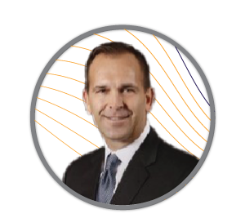
Conference
Welcome
Presented by:
Steve Bone,
MAP CEO

Slide 3



The Road Forward | WELCOME!
Get On The
Road Forward
Data, Digital, Defense!
Return Home
with Great Actionable,
Proven Ideas
Grow Your
Network
as part of our community
Notes:
“Windy Road” picture in the background

Slide 4





Introducing MAP 2.0 | Core Values
INTEGRITY
BIAS FOR
ACTION
NO
ENTITLEMENT
FANTATICAL ATTENTION TO
DETAIL
FUN

Slide 5


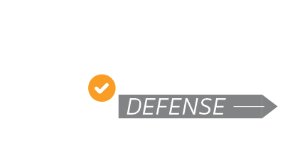
Introducing MAP 2.0 | Who Are We?
WE ARE
BUILDING
ADAPTING
DEVELOPING
A CUSO and a Challenger Brand
On 25 Years of Service
Quality
Faster Technology Adoption

Slide 6




MAP 2.0 | Adapt and Balance
Fast
Flexible
Frictionless
Fraud Free

Slide 7



MAP 2.0 | Proud to be a CUSO
Owned by 6 Credit Unions (All Clients)
20 to 1
92
10 to 1
Client-to-Strategic
Relationship Manager Ratio
Net Promoter
Score
Client-to-Service
Manager Ratio

Slide 8
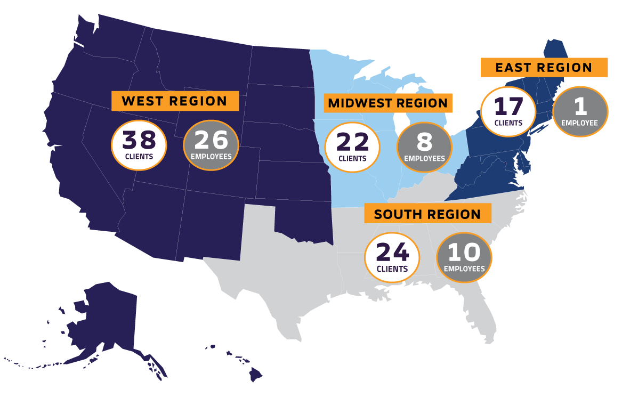
MAP 2.0 | Our People - By the Numbers

Slide 9



MAP 2.0 | Our Business - By the Numbers
40
~1mm
27
Debit / Credit Processing CU’s
Active Cards
Avg Monthly
Transactions per Card

Slide 10







MAP 2.0 | Our Clients
DEBIT Member Engagement - By the Numbers
37
35
34

Slide 11

MAP | Partners
Quality is Imperative, and our Partners are Critical to Delivering It

Slide 12












MAP | Partners

Slide 13






MAP | Owners

Slide 14







Slide 15


MAP 2.0 | The Future is NOW!
2025
2026
2027
CU Directed Use Cases
Asset / Accelerator Library
Microsoft Integrated Solutions
ETL, SDK, API Library
Transport (RPA, Scheduler) Assets
AI Solution Integration
VDM, Core, OB Asset Catalog
Standard Offerings - All Clients
Advanced AI Integrated Solutions
Digital Issuance – VDE SDK
CAB Directed VDE SDK Functions
DPS API’s – Activation / PIN Mgmt
CAB Directed VDE SDK Functions
Enhanced Faster Pmts Capabilities
Enhanced Fraud Capabilities
CAB Directed VDE SDK Functions
Enhanced Faster Pmts Capabilities
Enhanced Fraud Capabilities
AI Modeled Scoring
Risk Product Solution Suite
Push Notification Fraud Alert
CU Fraud Reporting Dashboards
Rules Assist Standard Offering
Enumeration Attack Offering
Advanced AI Integrated Solutions
Market Leading Fraud Forum
Market Leading Fraud Training
NEXT GEN
PLATFORM
Operating & Financial Models
1st Integrated Core - SW / Network
Pilot Credit Union in Production
1st Core - Scaled Implementations
2nd Core – Models & Integrations
2nd Core Pilot
3rd, 4th Core Models & Integrations
Implementations @ Full Scale
Complex Portfolio Readiness

Slide 16

Introducing
Partnerships with CU Industry Leaders
Accelerate Delivering Data Solutions Now!
MAP Products, Paper, and Secure Data Infrastructure (PCI Certified)
Start Small or Go Big – Tailor to Your Objectives and Budget
Re-Usable, Use Case Assets - Lower Cost and Risk
Our Partners are Presenting Today and Tomorrow!

Slide 17

Visa Data Manager
New MAP Enterprise License, Enables:
  Use-Case + “Modularized” CU Solutions
  Subscription and License
  Repeatable / Scalable Use Case Assets
  Card Data Integration – Up and Down Stream!

Slide 18












Visa Data Manager
Core
Power BI
Mobile / OB
LOS
One Drive
Collections
Descriptive Solutions
Predictive Solutions
Sales Force Ecosystem
Cards Dr / Cr
CRM Solutions
Marketing Solutions
CRM
GL

Slide 19



Data Science | Tech Solutions
CUSTOMER SEGMENTATION
Gain insights into your customers by categorizing them according to their engagement patterns
DATA VISUALIZATION
AND REPORTING
Implement controlled digital dashboards across your bank in a seamless manner using advanced technologies
PORTFOLIO GROWTH
In-depth examination of Loans and Deposits portfolios to deliver practical insights and strategies for growth and evolution
ANALYTICS ASSESSMENT
Is your Bank equipped for strategic intelligence? Do you possess the necessary infrastructure and tools?
PREDICTIVE ANALYTICS
Leverage existing data and historical trends to forecast future outcomes, trends, and insights
DATA SCIENCE
TECH SOLUTIONS
DEVELOPMENT & SUPPORT
Boost your technology development prowess and successfully finalize your projects
RISK PREDICTION
Continuously and proactively monitor and manage risk by benchmarking your risk factors against those of other FIs
DATA WAREHOUSING & TRANSFORMATION
Ensure organizational alignment by utilizing consistent and accurate data across all departments

Slide 20

Our Tech Expertise
BIG DATA
Snowflake, SQL, Structured,
Unstructured Data
CLOUD COMPUTING
Azure, AWS
IAAS, PAAS, SAAS etc.
SW DEVELOPMENT
Python, Frontend,
AI/ML, UI/UX
AUTOMATION
API, RPA, Integrations

Slide 21
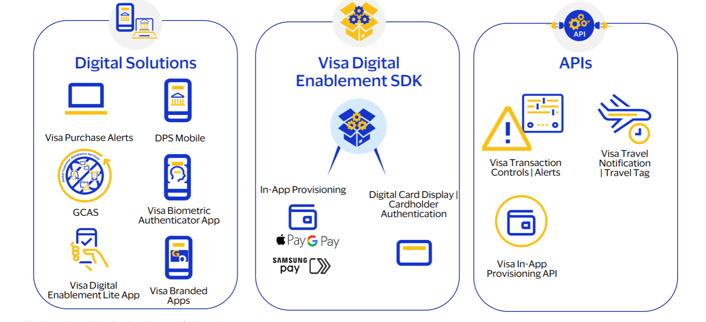
DIGITAL
FUNCTIONALITY
Lowered Servicing Cost
Digital Issuance
Mobile Wallet Push
Provisioning
Digital Card Display
Enhanced Experience
Mobile Banking App
DPS Mobile App
API & SDK
DIGITAL
ENABLEMENT
DIGITAL
CARD
Increased Revenue
Improved Retention
Dispute Management
Faster Payments Integration
Fraud Push Notifications
Subscription Manager
Card Controls & Alerts
Travel Notifications
Higher
Usage
Faster
Delivery
DIGITAL
SELF-SERVICE
DIGITAL
FUTURE

Slide 22

Visa Digital Enablement
Core
Mobile / OB
LOS
Fast
Collections
Flexible
Cards Dr / Cr
Frictionless
Fraud-Free
CRM
GL

Slide 23


Leveraging VISA’s Investment
$10B in AI Spend
$3B for Fraud Prevention
VIK Funds Availability
Advanced Authorization
Risk Manager
Risk Advisor

Slide 24
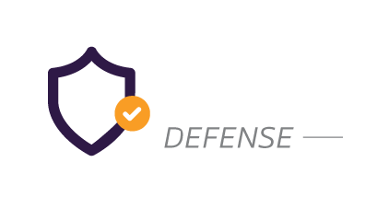

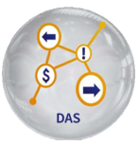







Multi-Layered Client Tailored Defense and Cardholder Contact Strategies
Issuer Cardholder Authentication Service
Dispute Analysis
and Support (DAS)
VAA Scoring applied to all networks and On-Us ATM
Risk Services Manager (RSM):
Flexible rule writing
Visa Resolve Online (VROL)
Managed Real Time (MRT):
Decline strategy based on FPR Tier
SUPPORT TEAM
Visa Interactive
Virtual Analyst (VIVA)
Risk Advisor
Falcon Case
Manager

Slide 25
MAP People and Processes
+ Visa Tools
Risk Application Expertise
Fraud Rule Writing Consultation & Implementation
Proactive Response - Visa Security Alerts and Risk Focused Webinars
Specialized Training
Risk Performance Analytics and Best Practices
Optimal Configuration and Product Analyses

Slide 26
MAP 2.0 - Internal Defense
Fractional Chief Information Officer
Todd Gengenbach
Strategic Partnership with
RSM, US, LLP
  30+ Years Experience Leading IT
  PCI DSS 4.0 Expertise
  Microsoft 365/Azure Advanced Certifications and Experience
  World’s Largest Middle Market Provider
  MAP’s IT Managed Services Provider
  Maximizing Microsoft Investment Value

Slide 27
MAP 2.0 Defense Infrastructure
Windows 365 / Azure PCI
DSS Environment
Secure Client, Prospect and
Vendor Collaboration Portals
  Segregated, Secure PCI DSS AoC Certified Environment
  Fully Redundant / Resilient Microsoft Cloud Technology
  Leverages Microsoft 365 SharePoint and Teams Technology
  PCI DSS AoC Certified

Slide 28
MAP 2.0 Defense Infrastructure
CYGNVS (Pronounced: SIG-NUS) Incident Response Solution
SentinelOne Endpoint and
Stellar Cyber SIEM Solutions
  Centralized , Omni Channel Tools
  “Air Gapped” to all Daily MAP Infrastructure
  Orchestrated with External Entities (Clients, legal, MSP, etc.)
  Customizable Workflow “Playbooks” for Multiple Incident Scenarios
  Leading Endpoint and (SIEM) CYBER Security
  Advanced AI to Assist Detect / Respond to Latest Threat Vectors

Slide 29



Thank YOU! | Our Asks of You
BE CHALLENGERS WITH US
TAKE HOME
NEW IDEAS
LET’S HAVE
SOME FUN

Slide 30
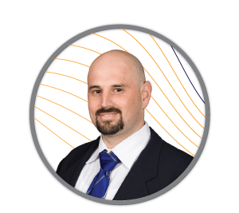
U.S. Economist
Visa
Presented by:
Travis Clark

Slide 31
Travis Clark | U.S. Economist - Visa
Leads U.S. State-Level Economic Forecasting Efforts
Translates Complex Economic Data / Concepts into Actionable Business Intelligence
Contributor to the Regional Economic Outlook and U.S. Visa Spending Momentum Index Reports
Masters in International Development Economics – University of San Francisco
Member – National Assoc. of Business Economics (NABE)

