Slide 2
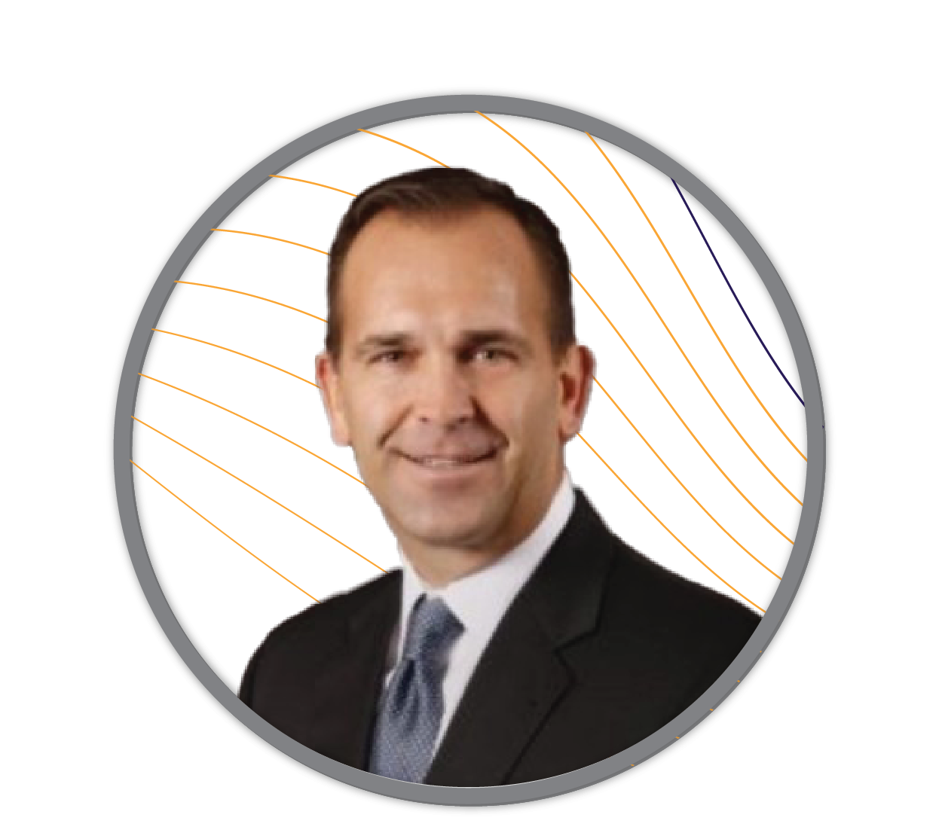
Welcome to DAY 2
Presented by:
Steve Bone
President and CEO
MAP

Slide 4
The Road Forward | DAY 1 RECAP
Learning from the Experts
Visa, Jim Stickley
RSM, Daon,
Data, Digital, Defense
Total Merchant Concepts
Partnerships
A BIG THANK YOU!

Slide 5
Partnerships, Client Success and Growth
Day 1 Focus = “What” Day 2 Focus = “How”
MAP, Partners and Credit Unions – Delivering Together
Our Community = De-Risking PROGRESS
Challengers Together, Serving the Mission

Slide 6
MAP 2.0 | Proud to be a Challenger Brand
PEOPLE’S CHAMPION
NEXT GENERATION
MISSIONARY
FIESTY UNDERDOG
ENLIGHTENED
ZAGGLER
REAL & HUMAN

Slide 7
MAP 2.0 | Proud to be a Challenger Brand
Defined by a determination to chase ambitions bigger than its conventional resources. Some of the world's most successful companies have transferred this core mindset to societal challenges.
Partners, Fractional Talent and the Cloud – Punching Above Our Weight
The Only Payments Provider to Guarantee Service Ratios
We Pick Up the Phone
The Future is NOW. Here’s Your MAP!

Slide 8
Growth and the Challenger Mindset
We believe that intelligent challenge is the oxygen of progress. And who doesn’t want to be part of a company that does that?”
ADAM MORGAN

Slide 10
Be a Challenger with us today!

Slide 11
Challenger Quiz
Which Challenger Would you Associate MAP With?
I took the Quiz:
The Real & Human challenges the impersonality and faceless service of the market leader, and the dehumanizing industrialization of the category, appealing to us on a more personal and emotional level. We are invited to think of this less as a brand and more as a group of people, constantly pushing to bring us something better and more extraordinary.

Slide 12
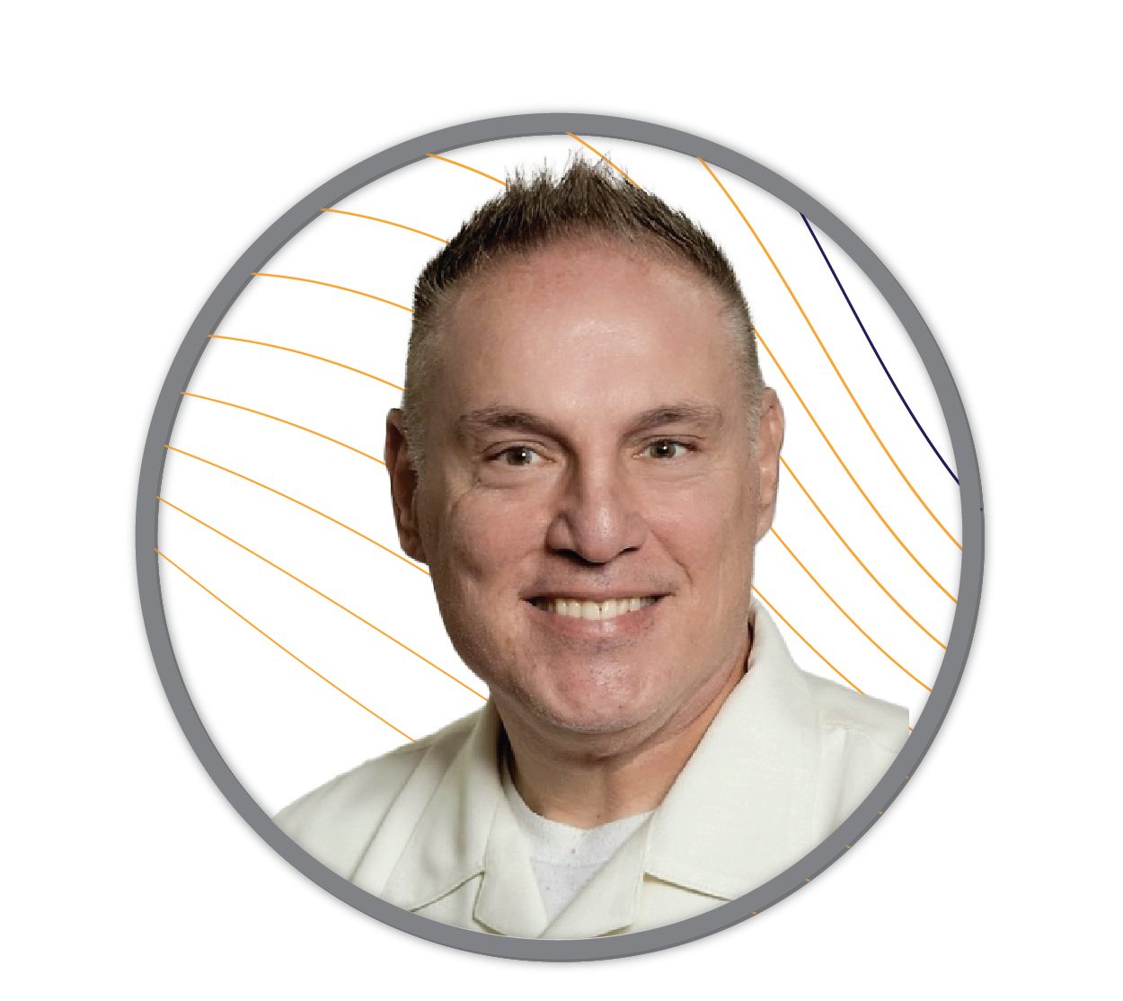
Lending Deeper
Presented by:
Seth Brickman President Ranqx

Slide 13
Seth Brickman
Innovative leader with a successful track record of building software products customers love to use
Transforming businesses through the use of data-based decision making and conversion rate optimization.
Head of Product for Amazon
Led high performing technical teams at Microsoft and Carnival Corporation.
Veteran of the US Navy
MBA Adjunct Professor

