Slide 2
3 Ways to Achieve Top-of-Wallet
INTRODUCTION

Slide 3
#1 Card Design Refresh
BRAND
AWARENESS

Slide 4
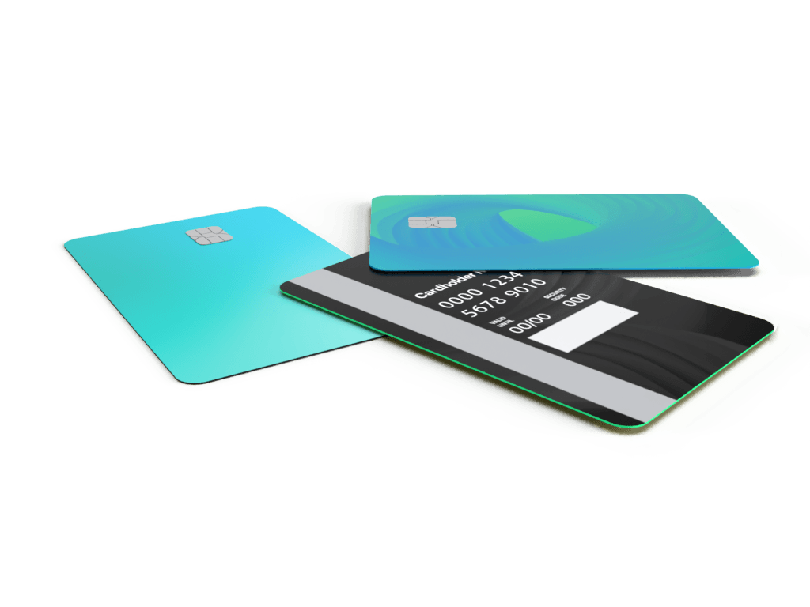
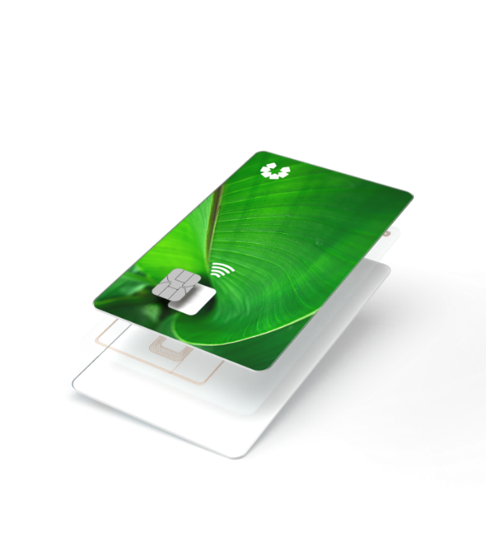
BRAND AWARENESS
Personalization on back
Colored core
Bespoke designs
Custom treatments
Eco-focused
Notes:
Personalization on back – branding on front – unobstructed, central focus
Colored core
Bespoke designs & Custom treatments
Eco-focused

Slide 5
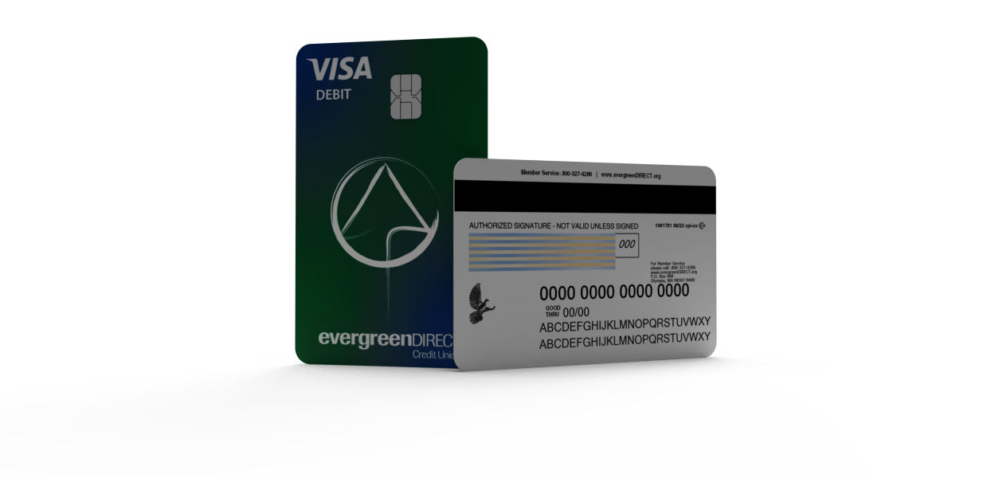
BRAND AWARENESS
Notes:
Personalization on back – branding on front – unobstructed, central focus
Colored core
Bespoke designs & Custom treatments
Eco-focused

Slide 6
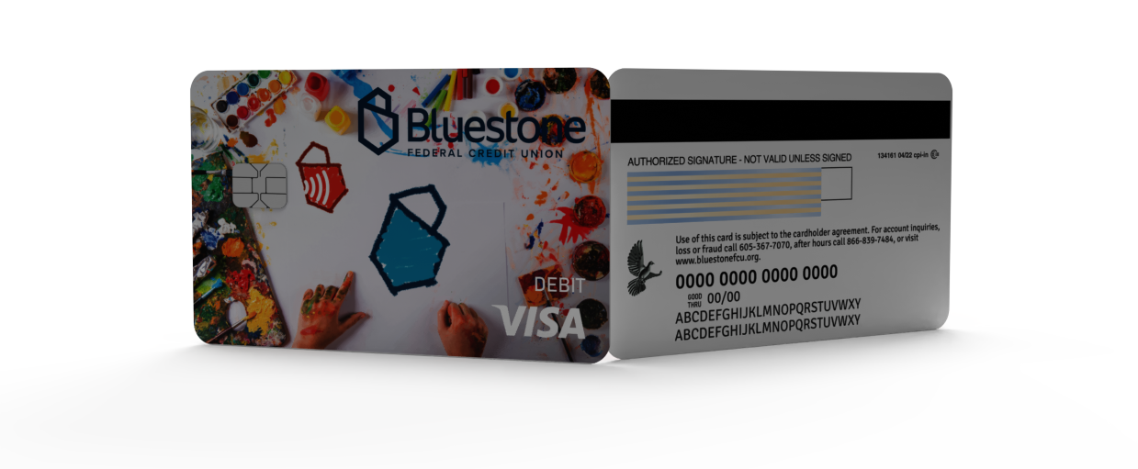
BRAND AWARENESS
Notes:
Personalization on back – branding on front – unobstructed, central focus
Colored core
Bespoke designs & Custom treatments
Eco-focused

Slide 7
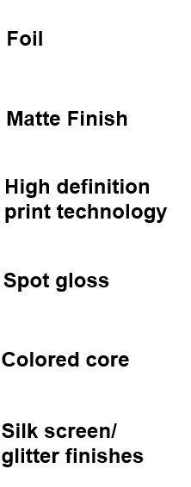
Card Design Enhancements

Slide 8
Eco-focused Cards
Notes:
Mastercard recommendation – by 2028, card should be made with materials that reduce first-use PVC
As adoption increases, price per card will decrease
Earthwise- 85% content – recycled core, recycled print layers (post industrial)
Second Wave- 74% - ocean bound plastic core, recycled print layers (post consumer)

Slide 9
#2 Contactless Functionality
MEMBER SATISFACTION

Slide 10
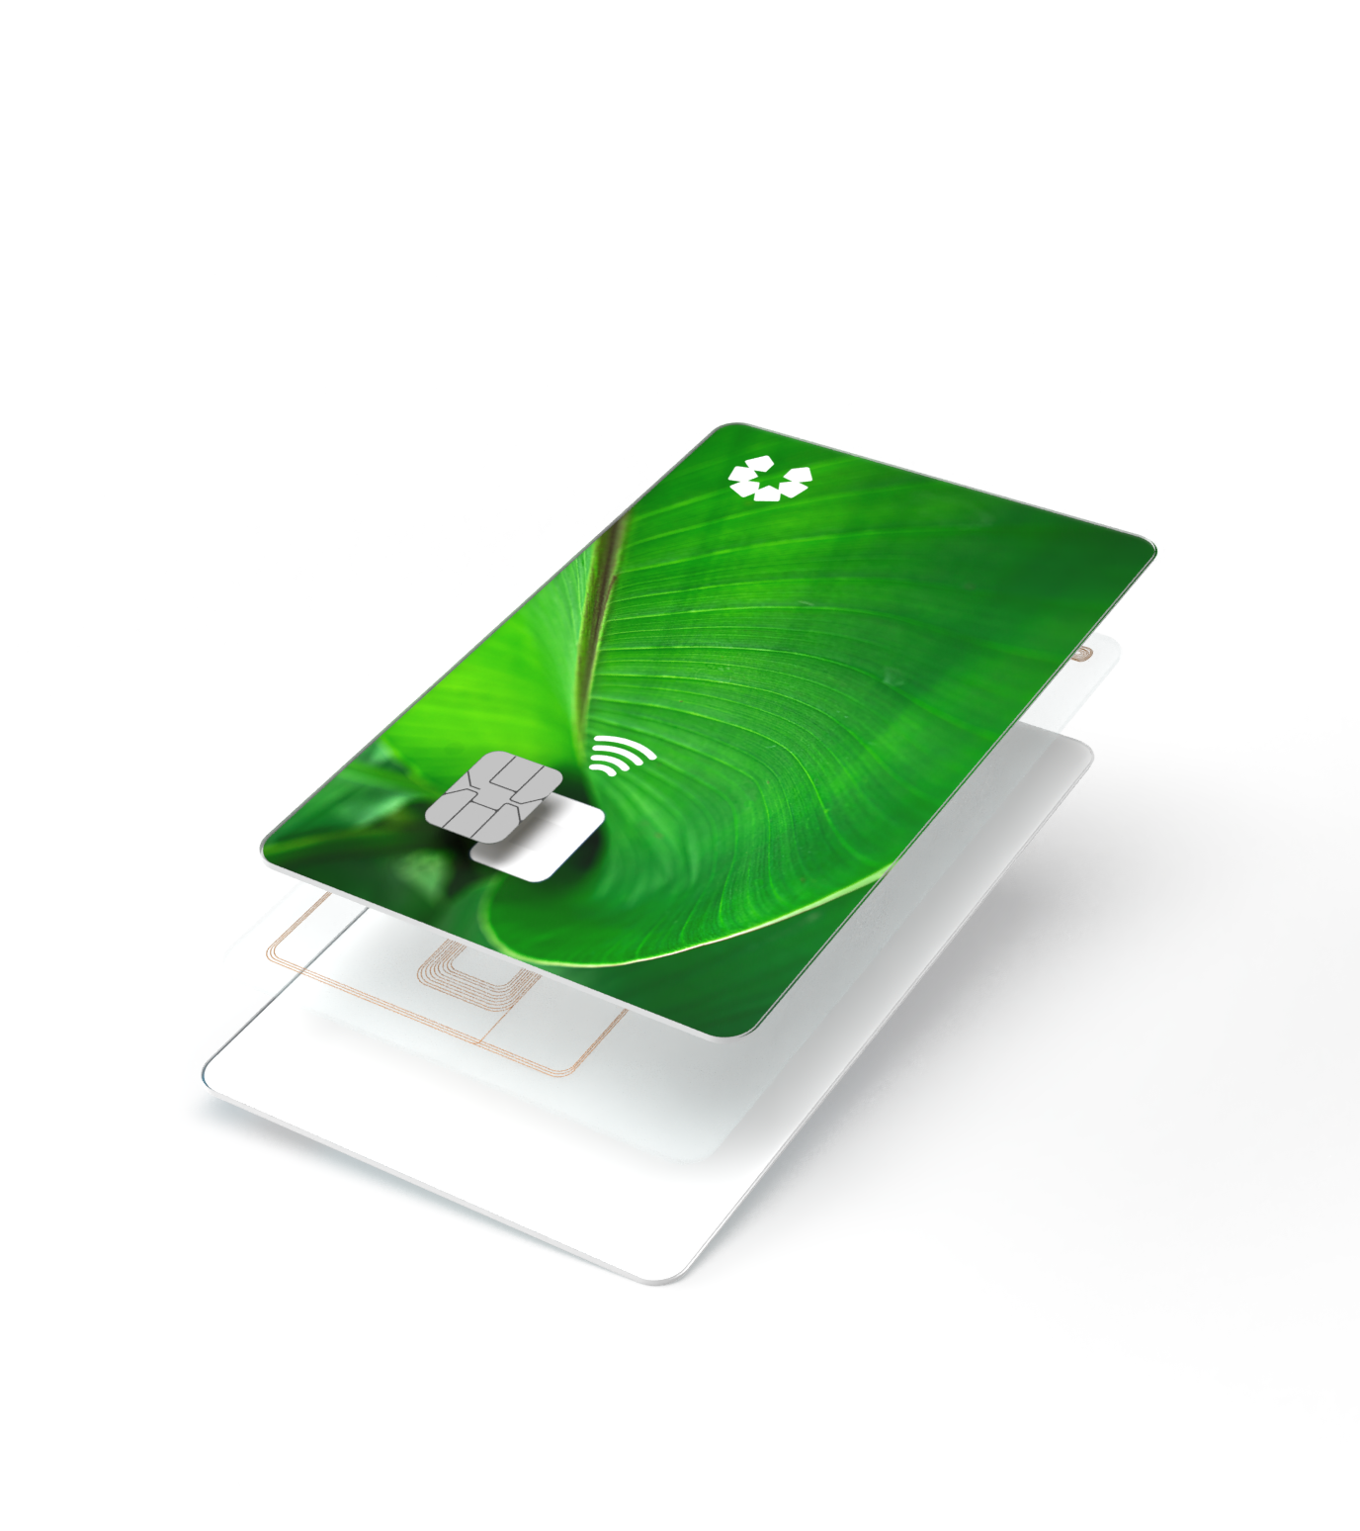
MEMBER SATISFACTION & CONVENIENCE
EMV and Contactless (Dual Interface)
Contactless antenna that provides a tap and go experience
Speedy and convenient experience for consumers
Metal and Eco-focused materials available with dual interface contactless certification
Digital Issuance
Notes:
Driving top of wallet –
Ask Bluestone - What was behind the decision to upgrade to DI?
Experience with Push Provisioning – Digital Wallets -
Evergreen - ????

Slide 11
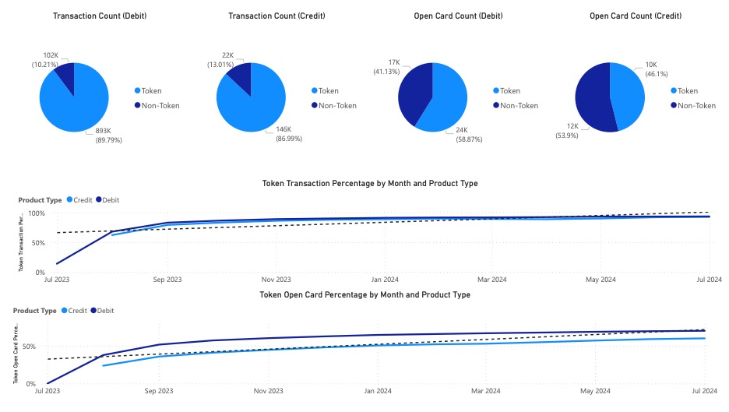
EVERGREEN TOKEN ANALYSIS

Slide 12
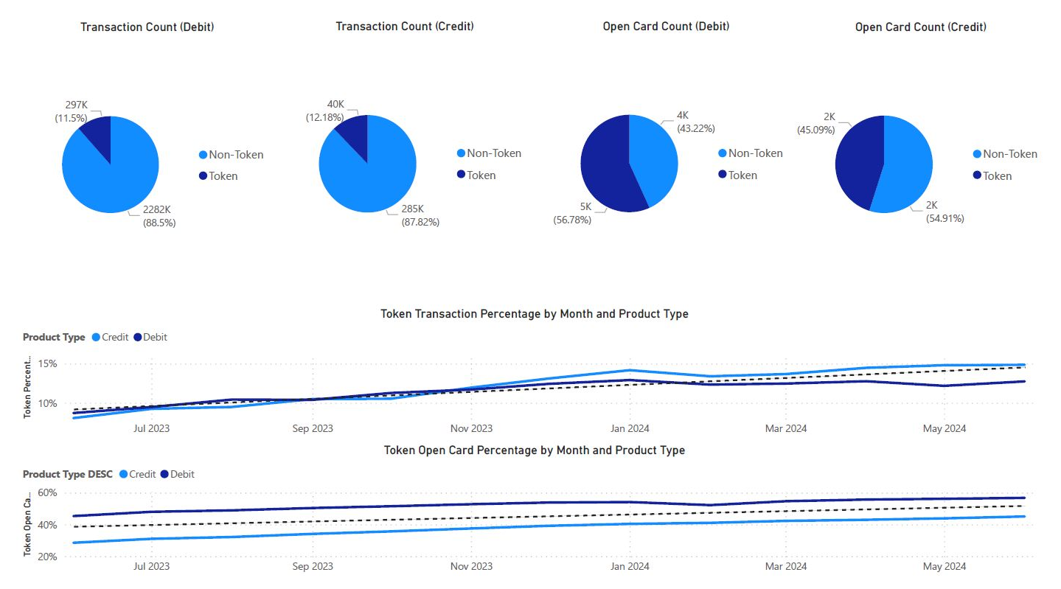
BLUESTONE TOKEN ANALYSIS

Slide 13
#3 Instant Issuance
COST BENEFIT ANALYSIS

Slide 14
COST BENEFIT ANALYSIS
Will be an infographic
Instant issuance has become the “standard of service”
Eliminate 10-day wait, cost per card savings (cheaper than central issuance), ROI 7-10 day interchange stat
$2 to $5 in incremental interchange revenue per active debit card within the first 30 days after instant issuance.³
32% increase in usage in the first 30 days for instantly issued debit cards versus those sent by mail.²
Note: Results may vary depending on mix of new cardholders receiving a new card and existing cardholders receiving a replacement card.
Examples provided are illustrative and financial institutions are encouraged to conduct their own calculations and evaluation using their proprietary information.
Sources:
¹ Sarah Grotta, Instant Issue Debit Cards: A Second Look, Mercator Advisory Group, May 2015.
² Tiffani Montez, Instant Issuance: U.S. Current State Assessment, Aite Group LLC, June 2017.
³ Range represents incremental debit interchange for non-exempt to exempt banks, assuming ten incremental transactions in the first 30 days after instant issuance multiplied by the debit transaction interchange rates as quoted by the federal government at www.federalreserve.gov/paymentsystems/regii-average-interchange-fee.htm (The Fed – Average Debit Card Interchange Fee by Payment Card Network, July 2019)
Notes:
Evergreen: questions about instant issuance and CAO

